Slide 1

How Tech companies effect city growth
Yatish Mullaji, Francisco Tang Bustillos, Irene Shtepa

Slide 2
Goal:
Observe how number of Tech companies in the city effects population, employment and salaries in the city

Slide 3
Scope of analysis:
Cities:
Austin
Boston
Chicago
Detroit
Houston
New York
San Francisco
Years:
2007 to 2016

Slide 4
Data Sources:
US Government Census data:
Population of the Cities
Payroll, yearly for metro area for the respective cities
Establishments (count years) for manufacturing sector and tech sector for the metro area
Employment (count years) for manufacturing sector and tech sector for the metro area
US Energy Information Administration:
Europe Brent and WTI (Western Texas Intermediate) Spot Prices
(daily)

Slide 5
Factors considered:
Data for Manufacturing & Mining, quarrying and oil & gas extractions were grouped together and considered under “manufacturing sector “ for the trend observations
Data for Information and Professional, scientific and technical services were grouped together and considered under “Tech sector “ for the trend observations

Slide 6
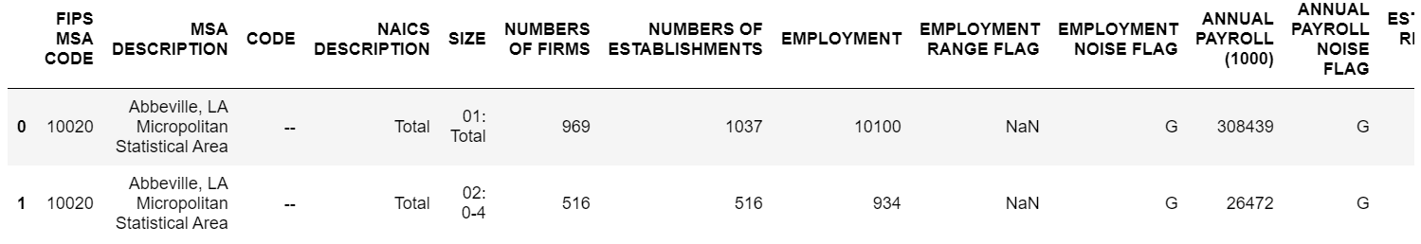
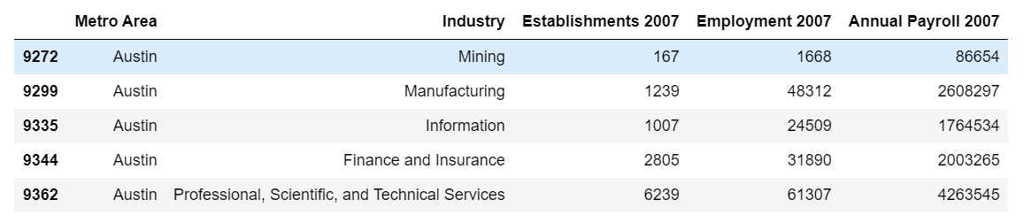
Cleaning data
Before:
After:

Slide 7
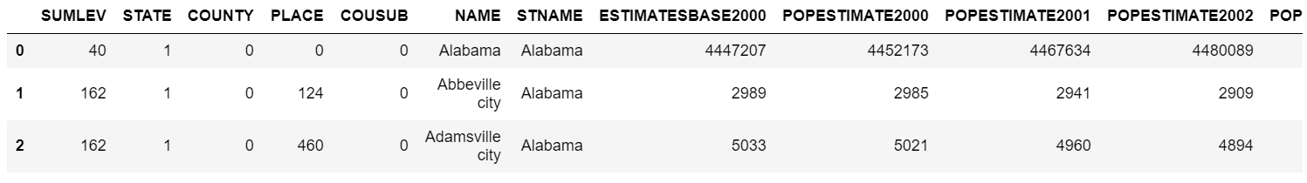
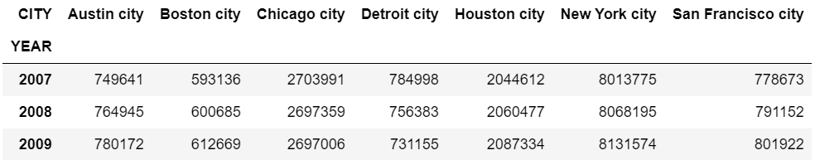
Cleaning data
Before:
After:

Slide 8

Trends analysis

Slide 9
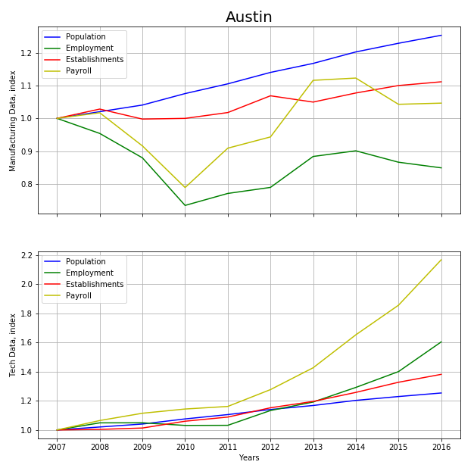
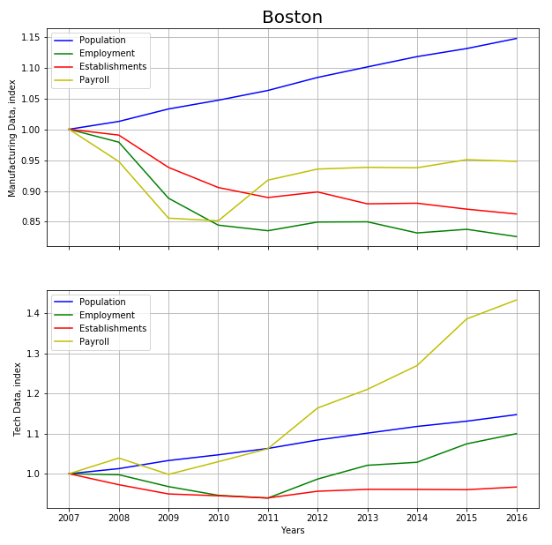

Slide 10
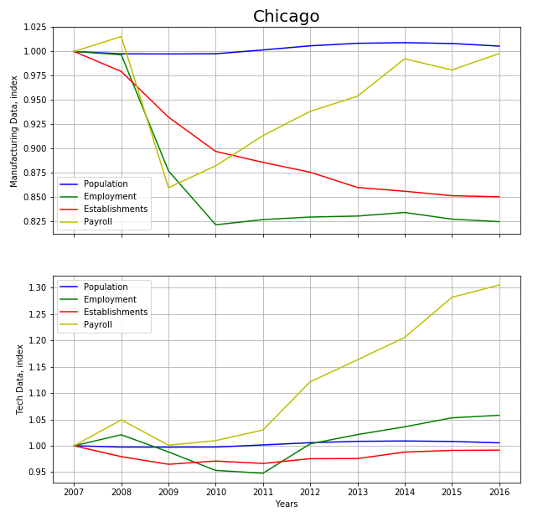
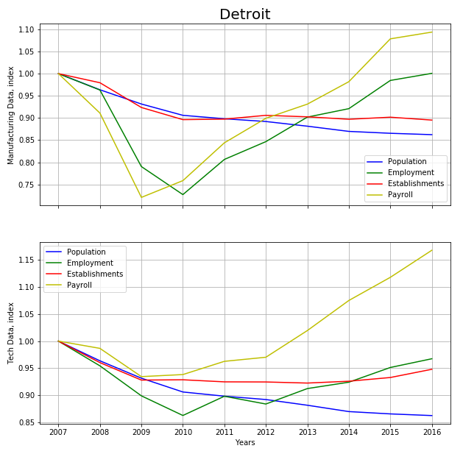

Slide 11
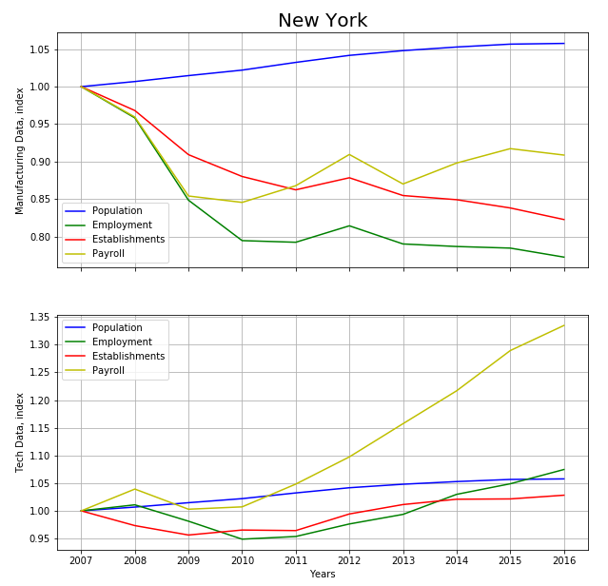
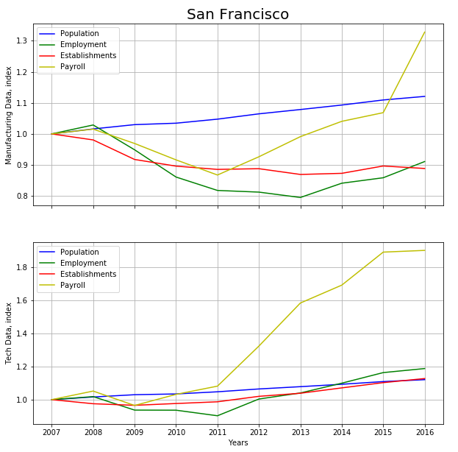

Slide 12
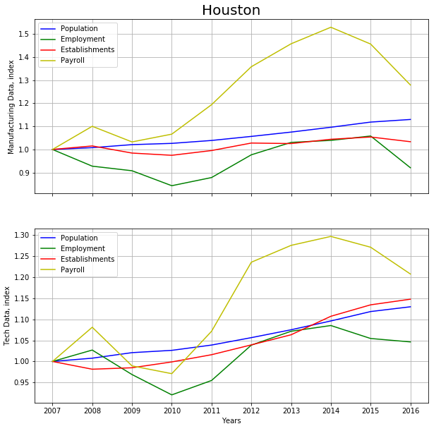

Slide 13
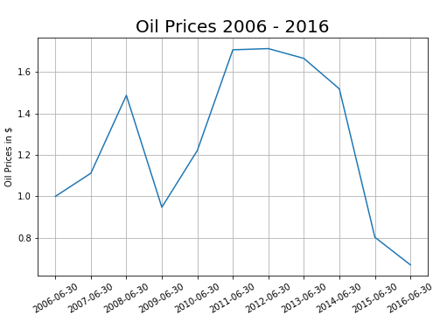

Slide 14
Next steps

Slide 15
Thank you for your attention
Questions

